Slide 1
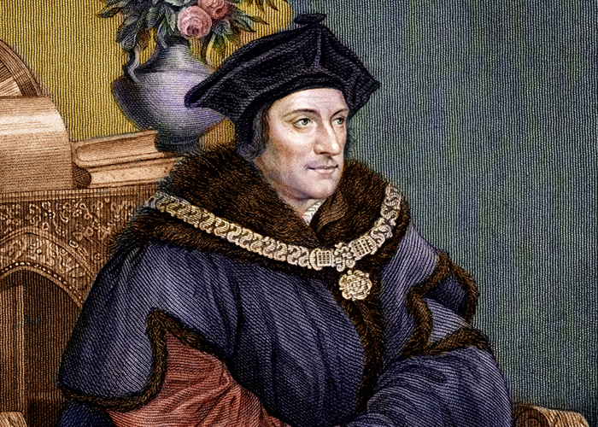
Thomas More Utopia
Dr. Stephanie Spoto
8/26/2021
Monterey Peninsula College
GENT 8/408: Late Renaissance and Reformation (1520-1600)

Slide 2
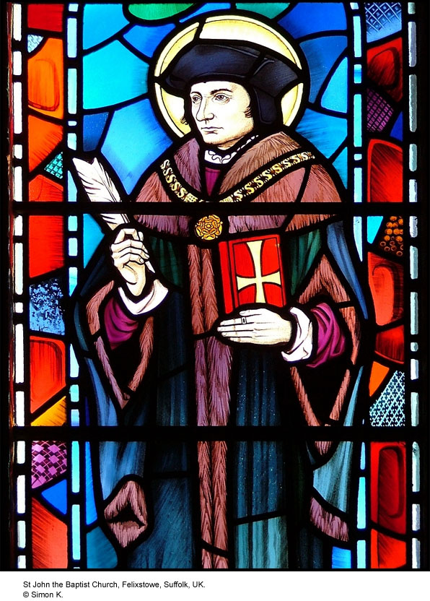
Thomas More, 1478-1535
Lawyer, philosopher, politician/statesman
Humanist
Patron saint of politicians
Born in London, educated in Oxford
Studied classics
Left after two years at father’s insistence to study law
Was interested in monastic life, but remained part of public life and married in 1505
Had four children, including Margaret Roper who was one of the most learned women in the sixteenth century.

Slide 3
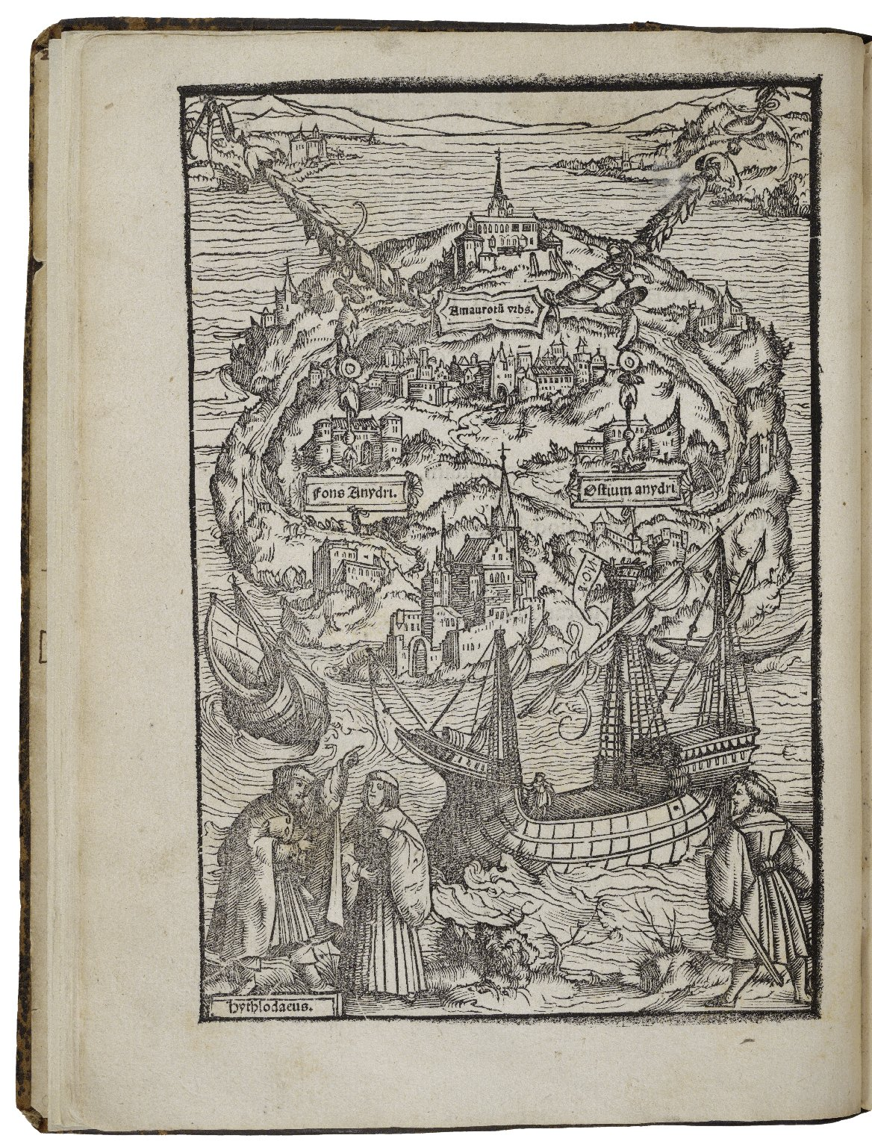
Utopia, 1516
More wrote a “utopia” → a perfect imaginary world
Imagines a self-contained island community with a complex, common culture
ou-topos: ‘no place’
eu-topos: ‘good place’
This pun asks a vital question → at the heart of the narrative and how we should interpret his intentions:
Can a perfect world ever be created?
For us: should we read this work as a serious political work? Or a satire through which More can comment on the chaos of sixteenth century European politics?

Slide 4
Naming and Fiction
Naming
Mixing reality with fiction
Raphael – “God’s healer” in Hebrew
Hythlodaeus – “distributor or peddler of nonsense” in Greek
Morus – “fool” in Greek
Begins with Thomas More’s correspondence with several people he had met on the continent: Peter Gilles (town clerk of Antwerp) and Hieronymus van Busleyden (counselor to Charles V)
More chose these letters, which are communications between actual people.
Further blurs the line between reality and fiction

Slide 5
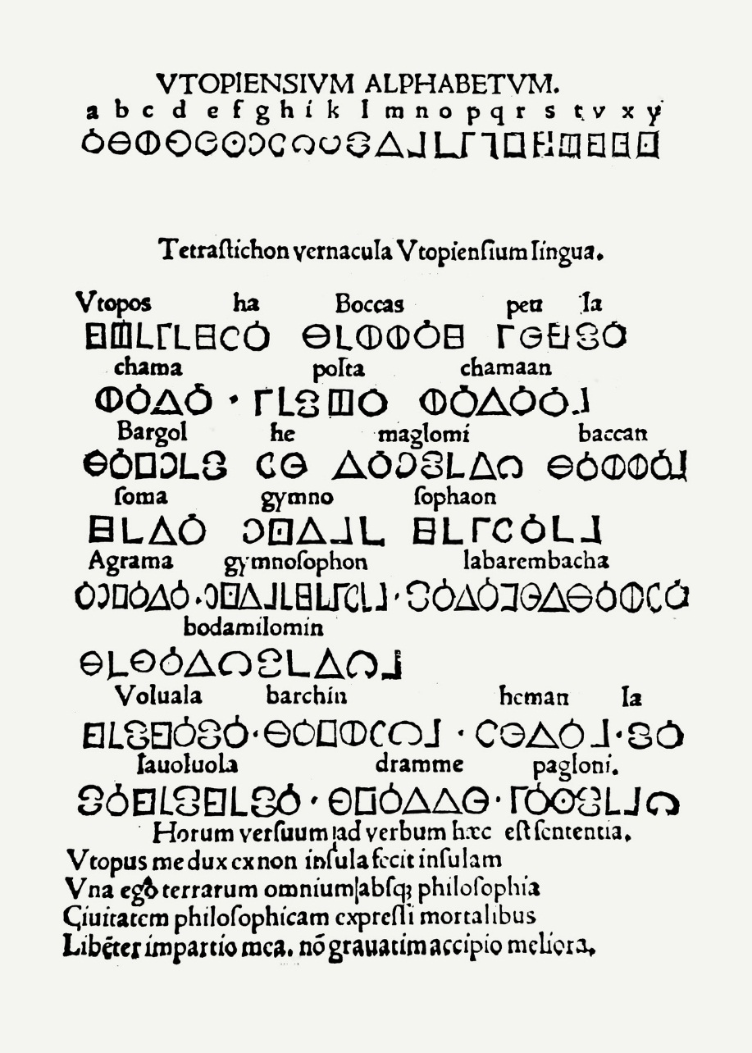
Book 1: Dialogue of the Counsel Fiction and Reality
Introduces the traveler Raphael Hythlodaeus, whom More meets while in Antwerp
Popular subject at the time: how to counsel a prince
Similar to the naming and including real people, these letters contain a specimen of Utopian poetry and the Utopian alphabet

Slide 6
Book 1: Dialogue of the Counsel Critiquing European Politics
Before talking about Utopia in detail, More and Raphael discuss the current state of European politics.
Tendency of kings to start wars
Loss of money
Criticizes the punishment of execution for theft → thieves might as well murder their witnesses if the punishment is the same
Enclosures of the common land causes poverty and starvation → leads to theft

Slide 7
Utopia as a response to the Enclosure of the Commons
Criticizes the practice of enclosure—the forceable enclosure of land previously held in common
Was the primary mode of sustenance living for the poor
Enclosures began as early as the 12th century, but rapidly increased in the 15th century as demand for wool rose
More claims that poverty and starvation followed → because people were not allowed access to the land

Slide 8
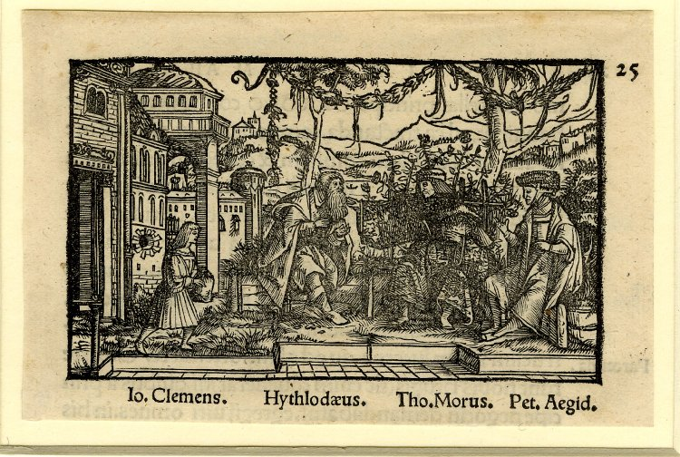
Conversation between Hythlodaeus, Morus and Petrus Aegidius in Antwerp 'De optimo reip. statu deque nova insula Utopia...', Basel: J. Froben, March 1518. Woodcut and letterpress.

Slide 9
Book 1: Dialogue the Counsel Raphael as New Plato
More pushes Raphael to get a position as advisor in a royal court → Raphael responds that he’s too radical.
Raphael sees himself in the tradition of Plato: goods rulers should be philosophers. However:
“Plato doubtless did well foresee, unless kings themselves would apply their minds to the study of philosophy, that else they would never thoroughly allow the council of philosophers, being themselves before, even from their tender age, infected and corrupt with perverse and evil opinions.”
More muses about practical philosophy – working in flawed systems to make them better or to start from the beginning (reform or revolution?).
After living there for five years, Raphael leaves Utopia in order to share what he’s learned there with Europe

Slide 10
The Island
Situated in the New World → Raphael Hythloday named as one of the 24 men who sailed with Vespucci
Continued on where Vespucci stopped and found Utopia
Living arrangements very regulated, with only a certain number of adults in each house, and a certain number of people in each city
Each regulated town has an elected representative (200 in total) → those elect a prince in a secret ballot
Goods and resources held in common and people just request what they need from a central warehouse

Slide 11
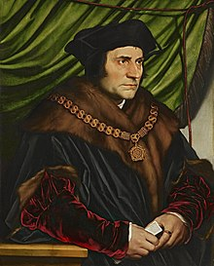
Book 2: Discourse on Utopia The regulation of life
Regulated populations: Utopians move to the mainland if it becomes too populated
Implied that Utopians are separate from the indigenous people on the mainland
No private property, no locks on doors, very little crime
Everyone must work → mainly in agriculture
Each person much work in agriculture for two years, and then can rotate out to a different occupation
Slaves: non-Utopians or criminal Utopians (for example, adultery and unauthorized travel are punishable by slavery)
Religion: all religions are tolerated, except atheism which is shameful

Slide 12
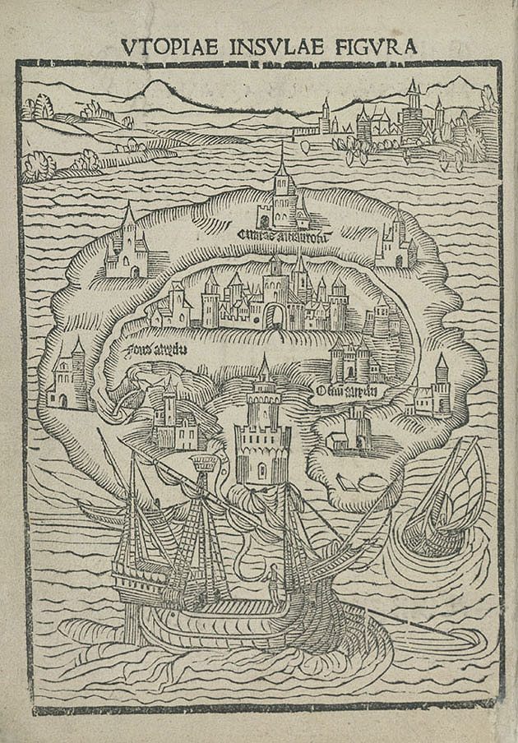
Book 2: Discourse on Utopia The role of women
In Utopia, women do the same work as men
Though there seems to be more equality (wives and husbands are subject to each other), there is division of some labor → women are more often restricted to domestic work.
Priesthood: some widows may become priests
Wives must confess their sins to their husbands every month
The role allocated to women in Utopia might, however, have been seen as being more liberal from a contemporary point of view.

Slide 13
Is Utopia a socialist text?
Utopia is a kind of socialist state, with no private property, no elevation of riches, and shared work.
While some scholars see More as supporting socialism, others see him as demonstrating how impractical it is.
Socialist text?: More wanted to show how socialism could work in practice. He lays out the workings of the cities.
In his other works, mentions of socialism sometimes seem supported and sometimes are scathing satires.
Raphael may be used to represent radical reformist of the day: he represents everything in idealized way → perfection.
It may be More’s ideal society → but the book’s title (“Nowhere”) might be a way to describe Utopia as impractical.

Slide 14
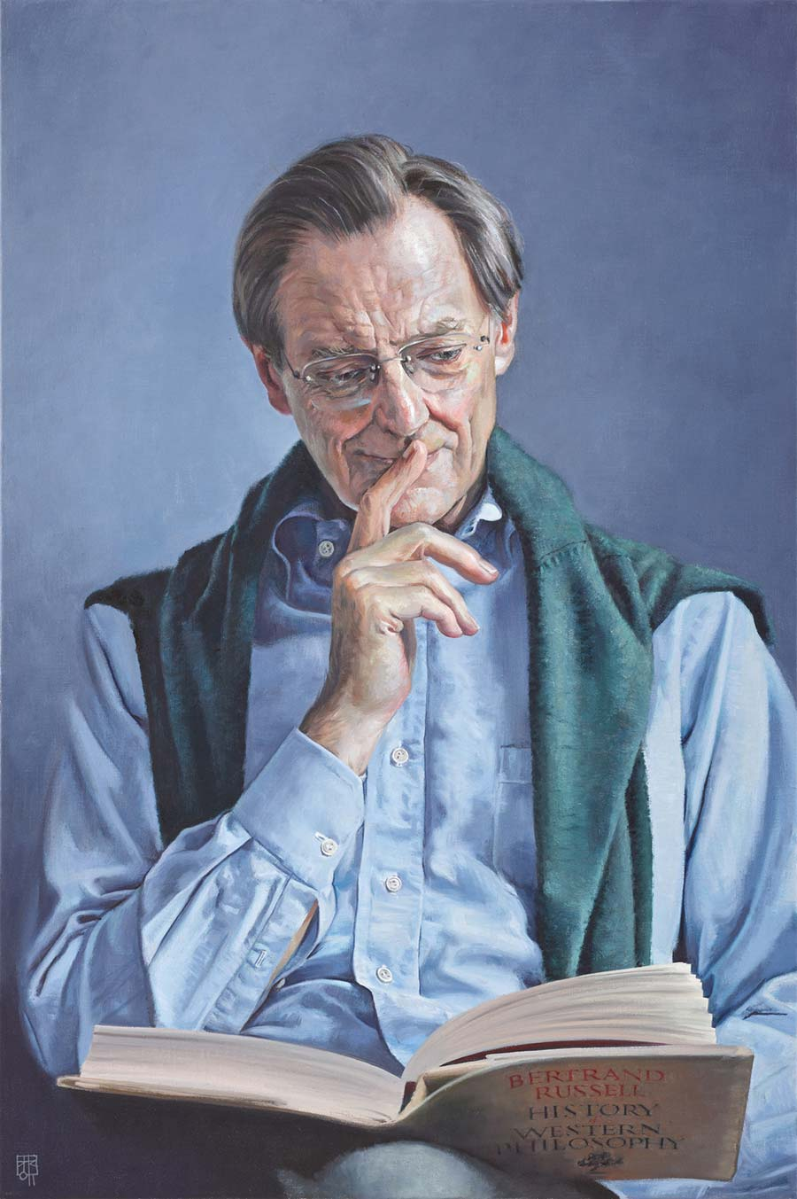
Quentin Skinner on Utopia
Skinner: intellectual historian (b. 1940)
Argues that More was exploring true nobility in the Renaissance humanist debate
Perfect nation could not occur with private property.
Raphael (Platonic view): philosophers should not get involved in politics.
More (Ciceronian view): more pragmatic.
Skinner: Raphael proposes a society that More desires → needs communism → More saw no possibility of communism
Therefore, we need to take a more pragmatic approach
DAVID COBLEY ‘PROFESSOR QUENTIN SKINNER’

Slide 15
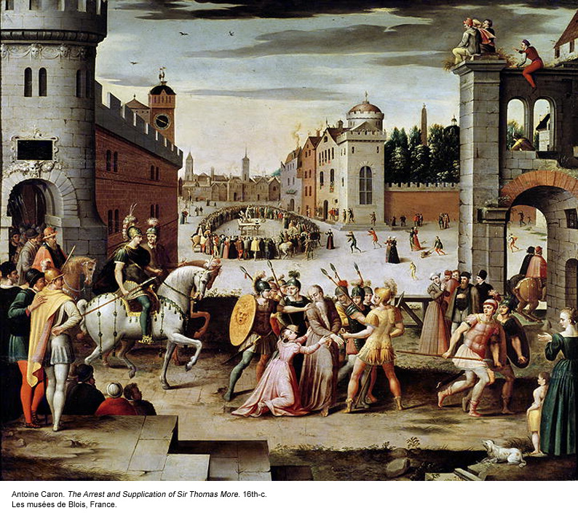
Thomas More’s execution
Many of the practices of the Utopians went against More’s beliefs (marriage, euthanasia, marriage for priests, women priests)
More devout Catholic
Opposed the Reformation and the separation of Henry VIII from the Catholic Church
Refused to acknowledge Henry VIII as head of the church → refused to recognize his annulment from Catherine of Aragon
Refused to take the Oath of Supremacy → convicted of treason and executed.
Of his execution, he was reported to have said: "I die the King's good servant, and God's first".

